Slide 1
Subset Sum Problem
Deanne Charan | Shreya Bhajikhaye

Slide 2
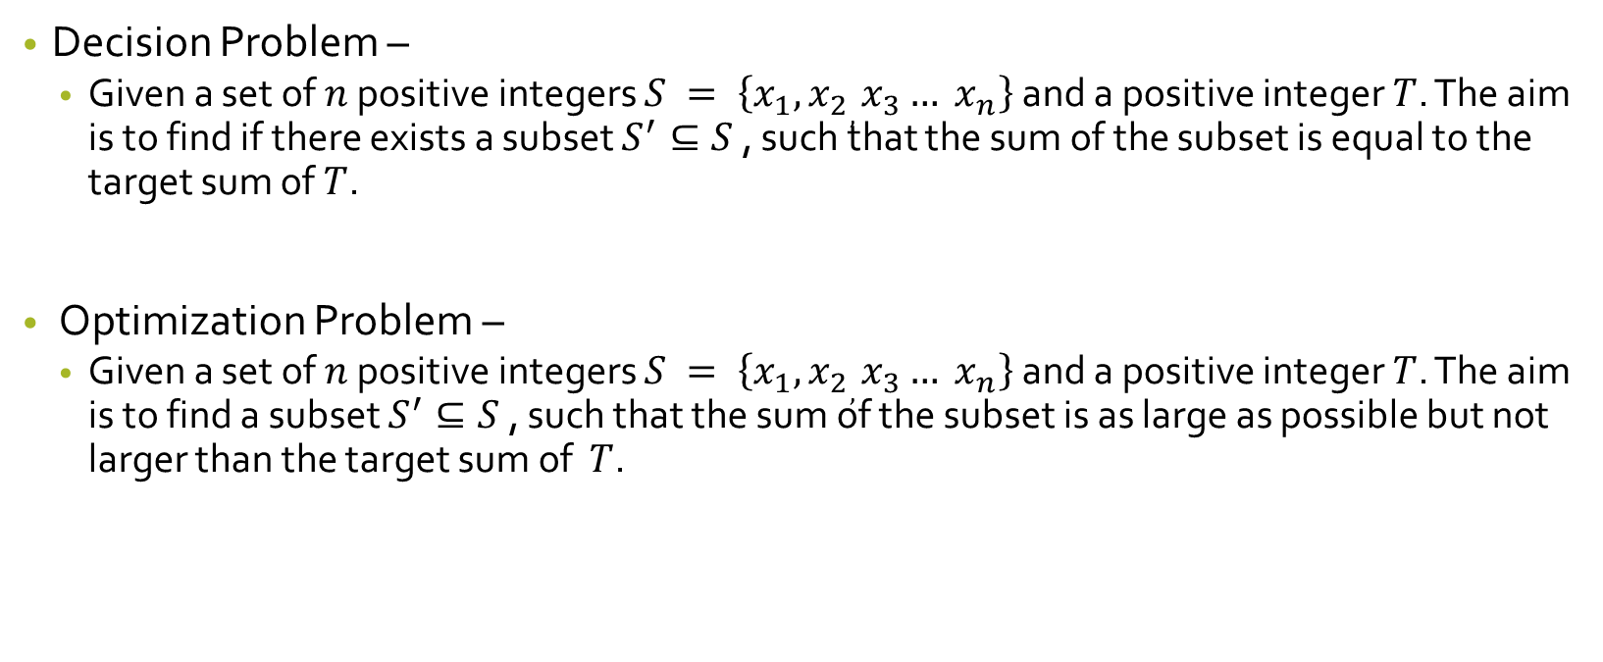
Overview
Decision Problem –
Given a set of $n$ positive integers $S = \left\{x_{1}, x_{2}, x_{3}… x_{n}\right\}$ and a positive integer $T$. The aim is to find if there exists a subset $S^{′}⊆S$, such that the sum of the subset is equal to the target sum of $T$.
Optimization Problem –
Given a set of $n$ positive integers $S = \left\{x_{1}, x_{2}, x_{3}… x_{n}\right\}$ and a positive integer $T$. The aim is to find a subset $S^{′}⊆S$, such that the sum of the subset is as large as possible but not larger than the target sum of $T$.

Slide 3
Applications
Subset Sum is mainly used as a decision problem in security applications
Public key cryptography
Message verification
Computer Passwords
The optimization version of the problem can be applied to many real world application
CPU with W free cycles, choose the set of jobs (each taking w_{i} time) that minimizes the number of idle cycles.
filling up a truck with loads of variable weight no greater than its capacity

Slide 4
Brute Force Approach
Subset Sum Decision
Iterate over all the possible subsets of the list and verify if subset sum is equal to target sum
Time Complexity : O(2^{n})

Slide 5
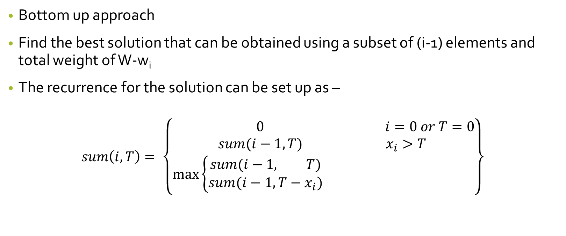
Dynamic Programming
Bottom up approach
Find the best solution that can be obtained using a subset of (i-1) elements and total weight of W-w_{i}
The recurrence for the solution can be set up as –
$$sum\left(i, T\right)= \left\{\begin{matrix} 0 & i=0 or T=0 \\ sum(i−1, T) & x_{i}>T \\ max\left\{\begin{aligned}sum(i−1, T) \\ sum(i−1,T−x_{i})\end{aligned}\right. & \end{matrix}\right\}$$

Slide 6
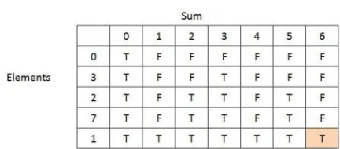
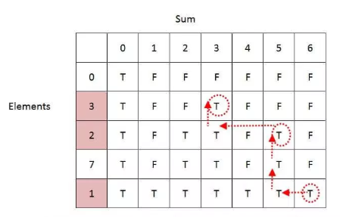
Example
S = { 3, 2, 7, 1} T = 6

Slide 7
Exact Algorithm
For iteration i
→ compute the sum of all subsets of {x₁, x₂, ..., x_{i}}
using as a starting point the sums of all subsets of {x₁, x₂, ..., x_{i-1}}
If sum of subset S’ > T then remove all elements greater than T
Example: Let S = {1, 4, 5}
L0 = {0}
L1 = {0, 1}
L2 = {0, 1, 4, 5}
L3 = {0, 1, 4, 5, 6, 9, 10}
So if the target was 9 we would have removed 10 from the last list.
Exponential run time

Slide 8
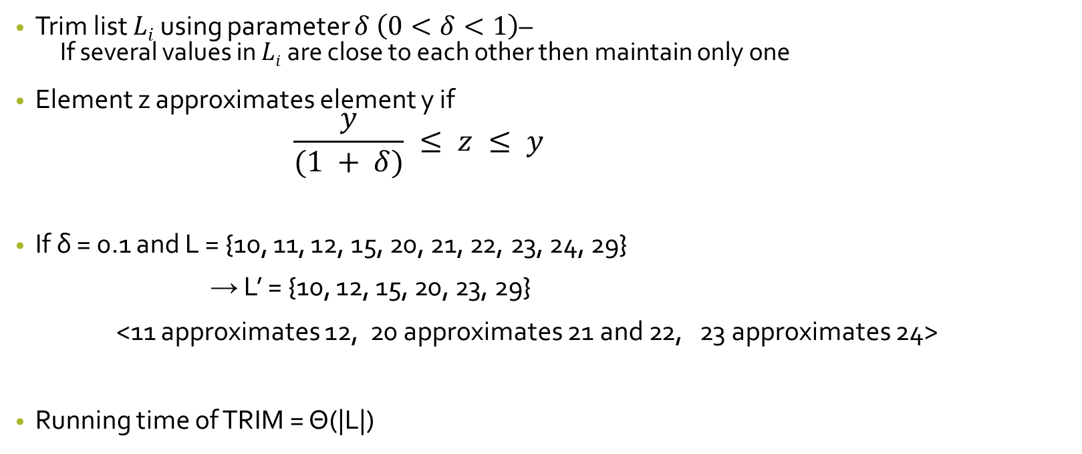
Approximation algorithm
Trim list $Li$ using parameter $δ \left(0<δ<1\right)$–
If several values in $Li$ are close to each other then maintain only one
Element z approximates element y if
$$\frac{y}{(1 + δ)} ≤ z ≤ y$$
If δ = 0.1 and L = {10, 11, 12, 15, 20, 21, 22, 23, 24, 29}
→ L’ = {10, 12, 15, 20, 23, 29}
<11 approximates 12, 20 approximates 21 and 22, 23 approximates 24>
Running time of TRIM = Θ(|L|)

Slide 9
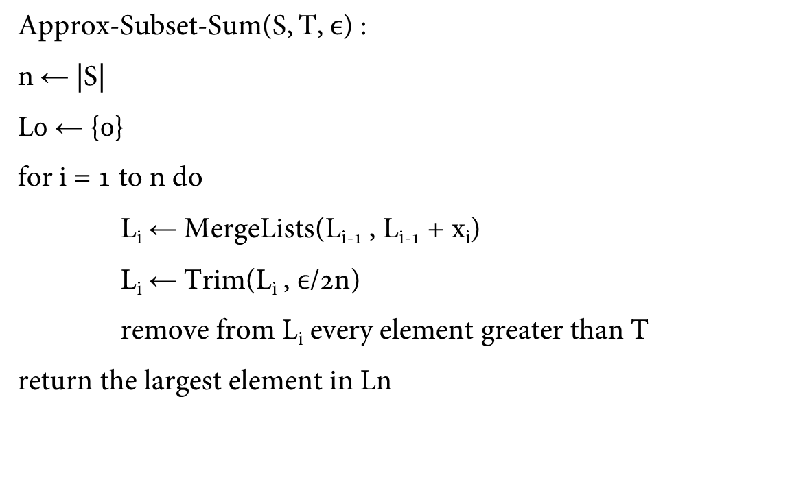
Approximation Algorithm
Approx-Subset-Sum(S, T, $ϵ$) :
n ← |S|
L0 ← {0}
for i = 1 to n do
L_{i} ← MergeLists(L_{i-1} , L_{i-1} + x_{i})
L_{i} ← Trim(L_{i} , $ϵ$/2n)
remove from L_{i} every element greater than T
return the largest element in Ln

Slide 10

Time Complexity Analysis
An approximation scheme for an optimization problem is an approximation algorithm that takes as input not only an instance of the problem, but also a value ε > 0.
We say that an approximation scheme is a fully polynomial-time approximation scheme if it is an approximation scheme and its running time is polynomial in both 1/ ε and the size n of the input instance.
The complexity of the algorithm depends on the length of the list being trimmed so we need an upper bound on the length of L_{i} .
This bound is polynomial in the size of the input—which is the number of bits lg t needed to represent t plus the number of bits needed to represent the set S, which is in turn polynomial in n and in 1/ ε.
Since the running time is polynomial in the lengths of the L_{i}, in turn we can conclude that the approximation scheme is a fully polynomial-time approximation scheme.

Slide 11
Example
S = {1, 3, 7, 9} T = 15 ε = 0.5
δ = 0.5(2*5) n = 5
L₀ = {0}
L1 = MergeLists(L₀, L_{o}+ 1) = { 0 , 1}
L₁ = Trim(L₀ , δ) = { 0, 1}
L₂ = MergeLists(L₁, L₁+ 3) = {0, 1, 3 , 4}
L₂ = Trim(L₁ , δ) = { 0, 1, 3, 4}
L₃ = MergeLists(L₂, L₂+ 4) = { 0, 1, 3, 4, 7, 8, 10, 11}
L₃ = Trim(L₂ , δ) = { 0, 1, 3, 4, 7, 8, 10, 11}
L₄ = MergeLists(L₃, L₃+ 9) = { 0, 1, 3, 4, 7, 8, 10, 11, 12, 13, 16, 17, 19, 20}
L₄ = Trim(L₃ , δ) = { 0, 1, 3, 4, 7, 8, 10, 11, 12, 13, 16, 17, 19}
Remove elements greater than 15 = { 0, 1, 3, 4, 7, 8, 10, 11, 12, 13}

Slide 12
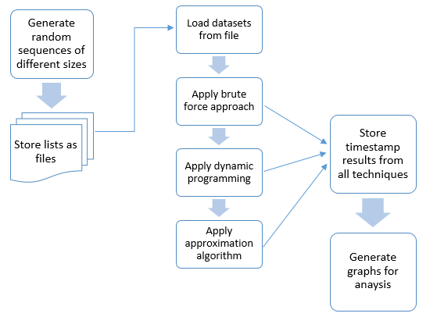
Implementation

Slide 13
Results for N=10
Size of Set | Sum | Brute Force | Dynamic Programming | Approximation Algorithm
n=10 | sum = 15 | 0.002029896 | 0 | 0.001028776
n=10 | sum = 120 | 0.002022505 | 0.002965689 | 0.003989458
n=10 | sum = 139 | 0.008006096 | 0.000996351 | 0.00302887
n=10 | sum = 150 | 0.010970831 | 0.001991987 | 0.002991915

Slide 14
Results for N= 100
Size of Set | Sum | Brute Force | Dynamic Programming | Approximation Algorithm
n=100 | sum = 450 | 0.047872066 | 0.033906937 | 0.331763029
n=100 | sum = 893 | 0.1077075 | 0.054849386 | 0.53264308
n=100 | sum = 1890 | 29.22697067 | 0.137632132 | 0.789700985
n=100 | sum = 2500 | 653.1802802 | 0.193481684 | 1.04523778

Slide 15
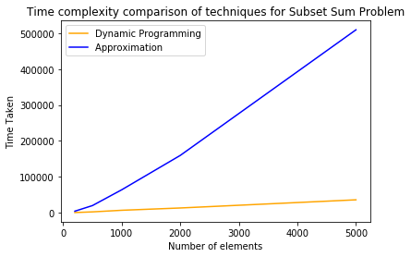
Results – Approximation algorithm with size of input
 |  | Dynamic Programming | Approximation Algorithm
n=200 | sum = 5219 | 0.65044 | 4.453635
n=500 | sum = 7500 | 2.519866 | 20.03768
n=1000 | sum = 10000 | 6.970169 | 64.03414
n=2000 | sum = 10000 | 13.3763 | 159.7378
n=5000 | sum= 10000 | 36.11272 | 509.4722

Slide 16
Results - Approximation algorithm with Epsilon
 | epsilon | time taken
n=100 | 0.2 | 1.914797
 | 0.5 | 1.249882
 | 0.8 | 1.015899
n=1000 | 0.2 | 167.3797
 | 0.5 | 105.302
 | 0.8 | 75.07632

Slide 17
Conclusion
The brute force algorithm is highly inefficient.
For a reasonable ε, the dynamic program and the approximation algorithm perform fairly similar for varying sizes of the subset and the sum.

Slide 18
Thank you!

